Slide 1
Access Controls
Linux 1 Day 2

Slide 2
Today’s Objectives
By the end of class, you will be able to:
Inspecting and setting file permissions.
Create and manage users and groups.
Elevate privileges with sudo and su

Slide 3
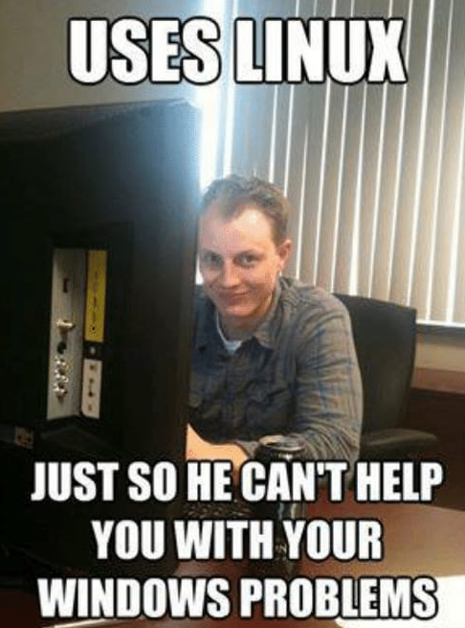

Slide 4
Like Google Docs,
Linux has access controls,
granting permission to access documents and files on a host.
Notes:
Access controls are important because if there are many users logging into a server, we do not want to have those users be able to access everything.
For example, if accounting and the IT department were using the same server, we would not want the IT staff exploring the documents of accounting or HR.
To prevent this we can make changes to the folders to prohibit certain kinds of access to it.

Slide 5
Inspecting File Permissions
-rw-r--r--
Notes:
We to this from ls –l
Point out to students that this list includes more information than just the file name. From left to right, the long listing displays:
File Permissions
The number of links to this file
Username of file owner
Group of the file owner
File size in bytes
Time of last modification
File name

Slide 6
Inspecting File Permissions
-rw-r--r--
Indicates file or directory
Notes:
SUID Bit: The first hyphen -. We'll discuss this later.

Slide 7
Inspecting File Permissions
-rw-r--r--
Owner permission (in this case, read and write)
Indicates file or directory
Notes:
Owner Permissions: The next three hyphens rw-, display the permissions the file owner has over this file. In this case, read and write.

Slide 8
Inspecting File Permissions
-rw-r--r--
Group Permission
Owner permission (in this case, read and write)
Indicates file or directory
Notes:
Group Permissions: The middle three hyphens r-- display the permissions other users in the file owner's group have over the file. In this case, just read.

Slide 9
Inspecting File Permissions
-rw-r--r--
Other / World Permission
Group Permission
Owner permission (in this case, read and write)
Indicates file or directory
Notes:
Other/World Permissions: The last three hyphens display the permissions that the general public has over the file. In this case, just read.

Slide 10
Changing File Permissions
File permissions can be set using two different notations: Symbolic and Octal
Symbolic Notation
r | read
w | write
x | execute
rwx rw- r--
User can read, write execute
Group can read and write
Others can read
Notes:
Symbolic Notation: uses the letters r, w, and x to set read, write, and execute permissions.

Slide 11
Changing File Permissions
File permissions can be set using two different notations: Symbolic and Octal
Octal Notation
rwx rw- r--
 | 4 | 2 | 1
0 | - | - | - | No permission
1 | - | - | x | Only execute
2 | - | w | - | Only write
3 | - | w | x | Write and execute
4 | r | - | - | Only read
5 | r | - | x | Read and execute
6 | r | w | - | Read and write
7 | r | w | x | Read, write and execute
4 + 2 + 1
4 + 2 + 0
4 + 0 + 0
7
6
4
764
User can read, write execute
Group can read and write
Others can read
Notes:
The read bit (r) having read permission on a file grants the right to read the contents of the file. Read permission on a directory implies the ability to list all the files in the directory.
The write bit (w) permission implies the ability to change the contents of the file (for a file) or create new files in the directory (for a directory).
The execute bit (x) allows the affected user to enter the directory, and access files and directories inside. Execute permission on files means the right to execute them, if they are programs. (Files that are not programs should not be given the execute permission.)

Slide 12
Activity: File Permissions
In this activity, you will practice inspecting and setting file permissions.
Instructions sent via Slack.
15 Minutes

Slide 13
Your Turn: File Permissions
Instructions
1. Inspect the permissions on the following files and directories:
/etc/shadow, /etc/passwd, ~/.bashrc, the directories in /home
Make sure to record the file permissions for these files
2. Next, create two new directories in ~/Documents, called GroupFAQs and PrivateData
3. In GroupFAQs, create three new files. Use any names you’d like
Grant “group” read access (but not write or execute), and restrict “other” access to these files
4. Change back to ~/Documents. Update the permissions for files in GroupFAQs such that they have "group" read and write access.

Slide 14
File Permissions

Slide 15
Users and Groups

Slide 16
Groups allow multiple related users to share file permissions.

Slide 17
Determining Group Membership
id
uid
gid

Slide 18
Adding Users
useradd
sudo adduser new_user

Slide 19
Adding Users
Instructor Demonstration
How do you add users to a system?
useradd, adduser
Advantages of adduser over useradd
Easier to customize user creation process
set user passwords
Create and manage groups / group memberships

Slide 20
Primary and Secondary Groups

Slide 21
Primary and Secondary Groups
Instructor Demonstration
A user’s primary group sets the group owner of a file or process when that user creates a file.
A user’s secondary group determines which files they have access to.

Slide 22
Creating and Managing Groups
sudo usermod -aG <groupname> <username>

Slide 23
Activity: User and Group
In this activity, you will run user and group commands and then answer the provided questions.
Instructions sent via Slack.
15 Minutes

Slide 24
User and Groups

Slide 25
Sudo

Slide 26
Sudo
Sudo is a safe way for normal users to run privileged commands that they shouldn’t always have access to.
sudo stands for superuser, allowing normal users to run a privileged command by entering their password.
Set up by installing the sudo package and then adding privileged users to the sudo group.
Once a member of the sudo group, they will have to enter a password everytime they want to run privileged commands.
The system administrator can also control which commands the user can run as root.

Slide 27
Using sudo
Using sudo
Controlling available
commands
Logging

Slide 28
Activity: Sudo Wrestling
In this activity, you will interpret suspicious activity occurring in an auth.log file.
Instructions sent via Slack.
10 Minutes

Slide 29
Sudo Wrestling
10 Minutes
Instructions
Add your new user to the sudo group to allow them to run nano and/or vi as root.
This allows them to read and modify root-owned files, such as /etc/passwd and /etc/shadow
Determine which user's account has been compromised
Inspect sudoers log for evidence of brute-force attempts to sudo cp /etc/shadow to a directory in /home
Identify which user was attempting sudo
Search for other suspicious activity in that user's .bash_history
Remove that user from privileged groups
Change that user's password or remove their account

Slide 30
Sudo Wrestling

Slide 31
Switching Users

Slide 32
Switching User
su <username>

Slide 33
Activity: su-per Privileged
In this activity, students will crack user passwords, and then use su to run files they ordinarily don’t use
Instructions sent via Slack.
10 Minutes

Slide 34
Your Turn: su-per Privileged
Instructions
Cracking Passwords
What happens when you try to read /etc/shadow? Why does this happen?
An administrator left a copy of /etc/shadow in one of the tmp directories. Find it.
Create a new folder in your Documents directory, called .hidden, and change into it.
Move the copied shadow file you found into .hidden, and change into .hidden.
There's a program called john-the-ripper on your VM. Run it, and pass the shadow file as argument.
What do you see when john finishes running? Record your response.
Finding the Flag
One of the users has a "flag" file somewhere in their home directory that is executable.
Find out who, and what the path to the file is.
Use the passwords you just cracked to login as the user who owns the flag.
Move into the directory you found, and run the flag file.
If all goes well, you should get a message verifying that you have found the flag!

Slide 35
su-per Privilege

Slide 36
Today’s Objectives
By the end of class, you will be able to:
Inspecting and setting file permissions.
Create and manage users and groups.
Elevate privileges with sudo and su

